Slide 1
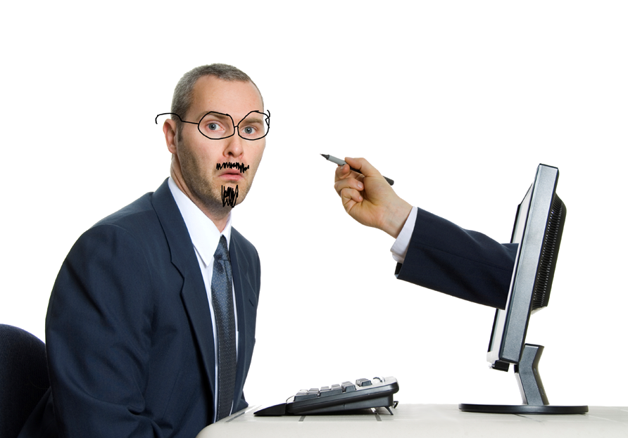
How To Respond To Negative Comments (and yes, you SHOULD respond)
We’re sorry you had a negative experience with one of our products. This isn’t the kind of experience we want our customers to have and we would like to investigate this issue further. Please email us at _______ so we can improve your situation.
Oh no! We’re so sorry to hear you had a bad experience. Please email us at ______ and we’ll see what we can do to help. Thanks for your letting us know.
We’re sorry to hear about your experience and are here to help. Please email us at ______ so we can follow up with you personally. Thanks for bringing this issue to our attention.
We’re so disappointed to hear you had a bad experience, and we are sorry! Please message us at ______ so that we can discuss how to fix this with you. We would like the opportunity to make this right because customer care is important to us!

Slide 2
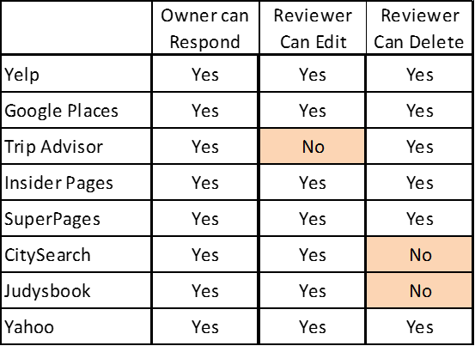
Tips For Responding To A Negative Review Or Comment:
Listen to the customers: Read what they wrote and respond to what they wrote, but don’t attack or be rude.
Be honest about mistakes, but, don’t apologize for things that are policy, or won’t change.
Explain policy when relevant.
Write in plain language.
Reach back to the goals of the company, that you want people to be happy – vow to do better.
Don’t offer a discount.
Respond with a confidence in your business and your employees.

Slide 3
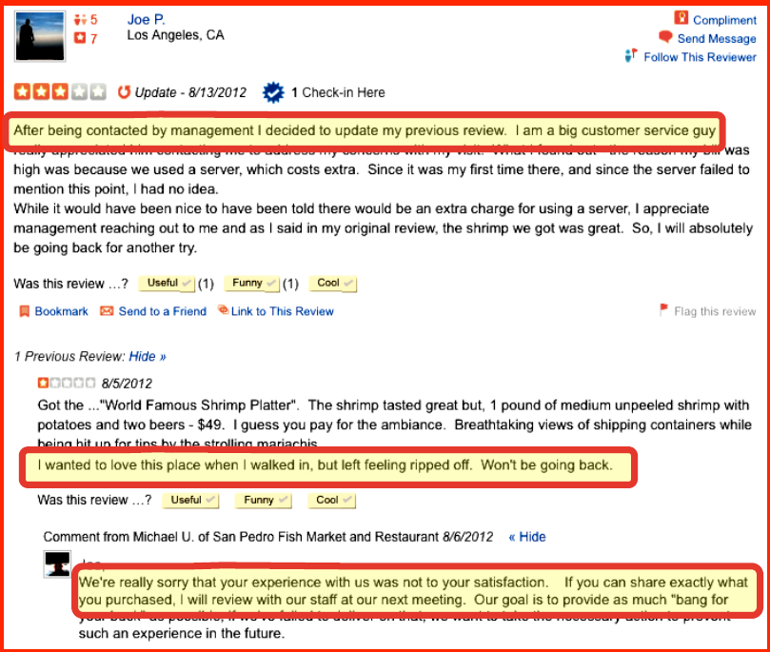
Person amends his review and changes to 3 stars
Person posts a 1 star negative review
Business owner responds promptly & sincerely

Slide 4
When contacted about a negative review:
34% of users deleted the negative review
33% of users changed the review in to a positive one
(Source: Harris Interactive, Retail Consumer Report)

Slide 5
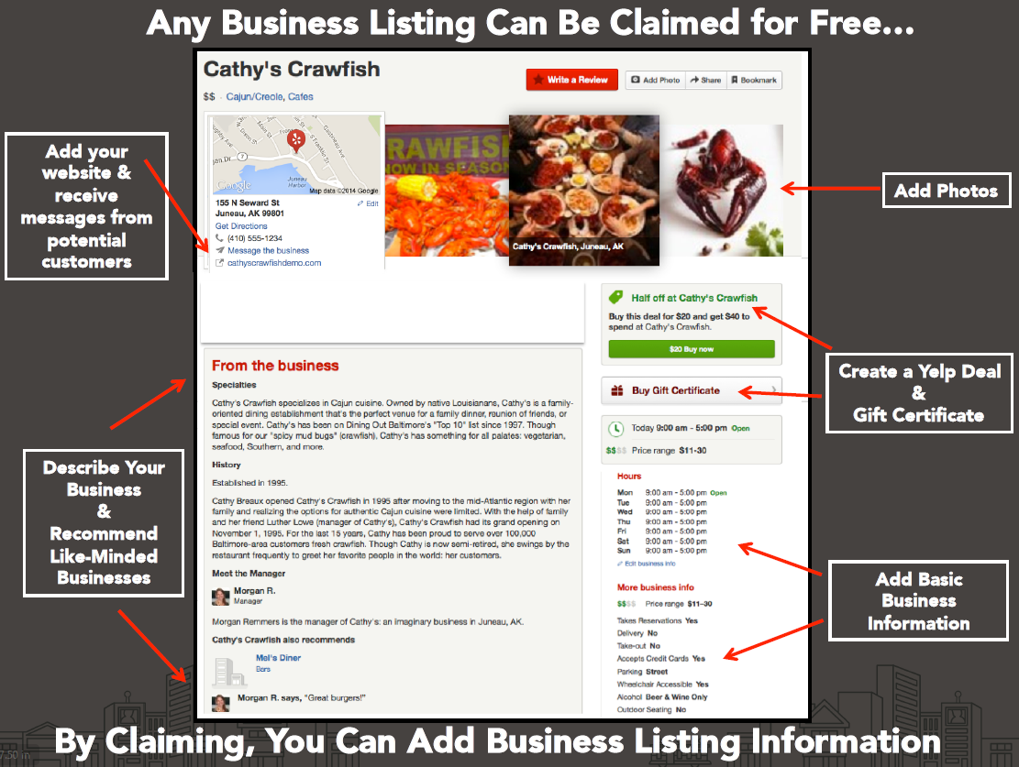
Tips From YELP On Stimulating Positive Comments:
Make sure the business has been “claimed”

Slide 6
Tips From YELP On Stimulating Positive Comments:
Connect with customers and thank them for sharing

Slide 7
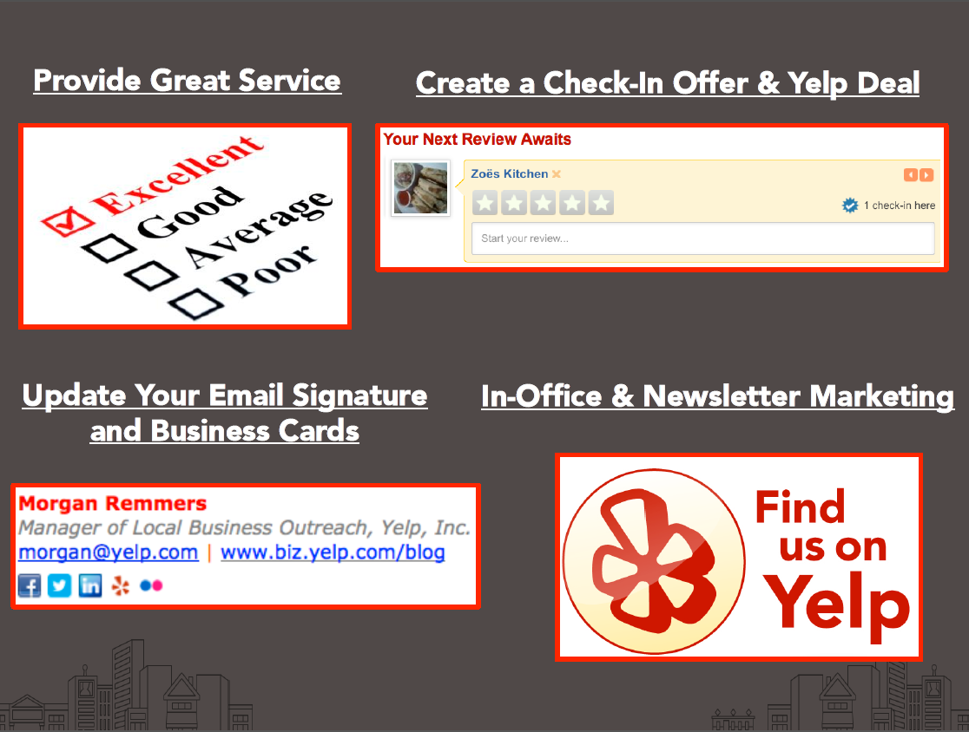
Tips From YELP On Stimulating Positive Comments:
Let people know how to find you easily

