Slide 1
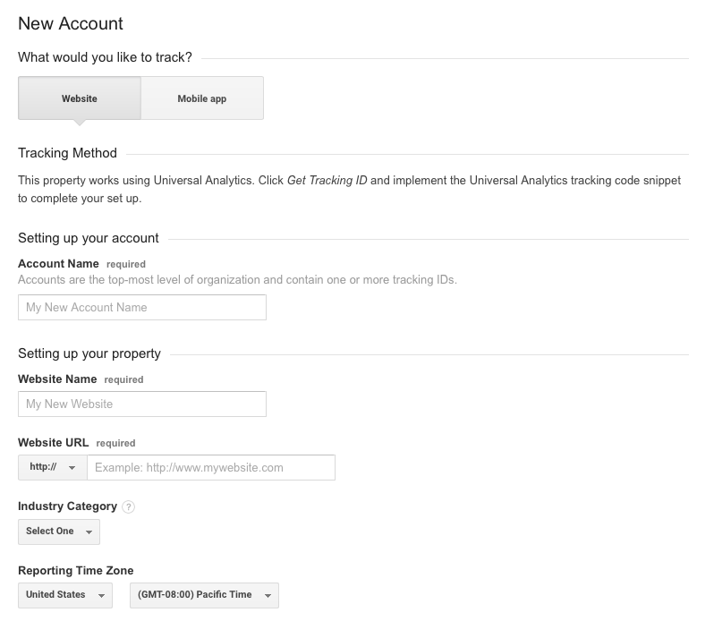
Installing Google Analytics On Your Website
Step 1: You will need a Gmail account to register for Google Analytics. Once you have that active Gmail address, type in analytics.google.com to get to the signup screen.
Click “sign up.” You’ll be taken to the analytics signup page. You’ll need to pick a name for your account, enter your website address (Example: http://www.my-website.com), industry, and time-zone.
For the data sharing settings, typically just leave all of those boxes checked. When you’re done, click “Get Tracking ID.” You’ll need to accept the Google Terms and conditions. You’ll be taken Google Analytics Dashboard. Here you’ll see your Google Analytics Tracking ID as well as the block of code you’ll need to add to your website.

Slide 2
Step 2: The Google Analytics Tracking ID needs to be added to your website. Depending on the platform your website is created on there may be a plug-in you can download and then paste the code into the plug-in. If not, simply copy and paste the code block after the opening body tag on any page you’d like to track.
Your website is now setup to start collecting analytics data!
Note: Google Analytics takes roughly 24 hours to start displaying data in your dashboard.
For Google’s free tutorials on Google Analytics: https://analyticsacademy.withgoogle.com/explorer

