Slide 1
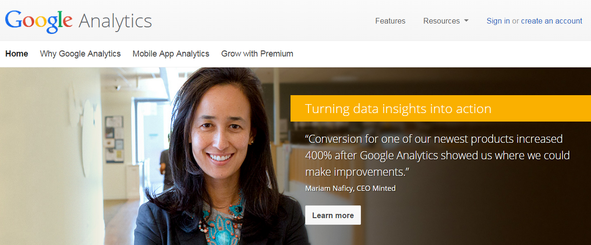
To be added as an “admin” go to: www.google.com/analytics
Notes:
If your client doesn’t know how to grant you access to Google Analytics – here is what they need to do:
Go to www.google.com/analytics and click sign in. They sign in with whatever gmail account is tied to their Google Analytics page

Slide 2
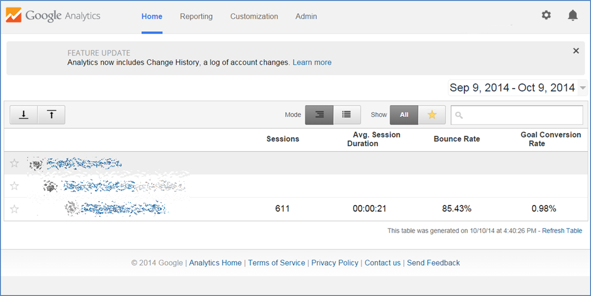

Slide 3
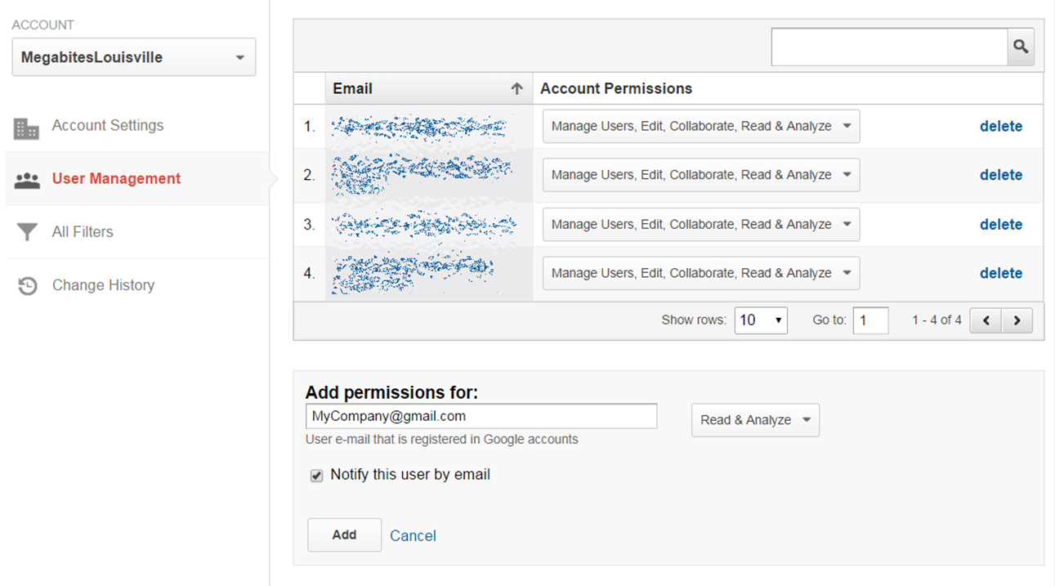
The client enters the gmail address of your company to grant access – get this from your Digital Sales Manager

Slide 4
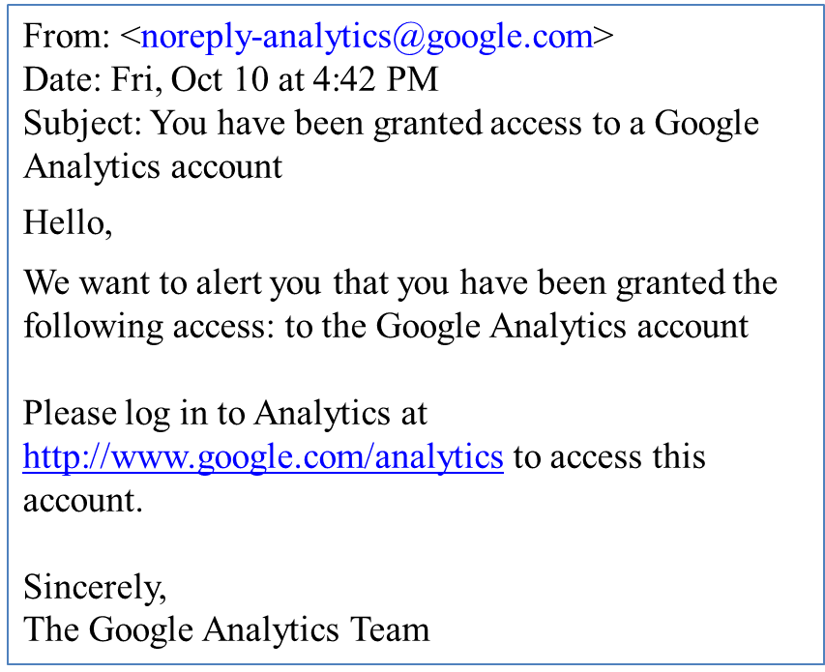
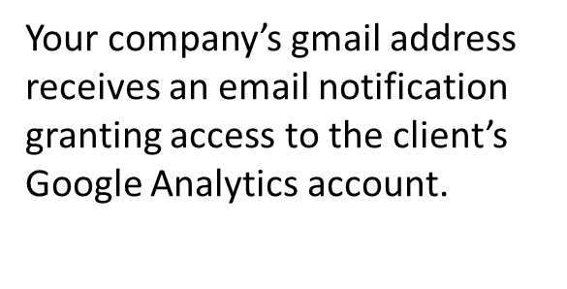

Slide 5
You can now walk your client through how to ad your company as an “admin”. There is also an easy step-by-step “How To Add A Google Admin” is in your shared drive in the “Pre-Campaign Checklist” file.

